Slide 1
Notes:
Introduce the Qliteracy Committee
Vanessa Collins (JS Curriculum Coordinator & Isaac Dargan (Year 4 teacher)
Merrilyn Lane – Science teachers
Catherine Phoon – Head of Specailised Programs
Lindy Walsh – Catalyst Coordinator
Antony George – Head of English
Myself

Slide 2
Functional Reading vs Reading for enjoyment
Functional reading is the reading we (often) impassively do to navigate our lives.
Reading for enjoyment is reading we choose to engage in. In our current digital dominant lives this type of reading APPEARS TO HAVE dwindled significantly.
Notes:
Functional reading is the reading we do without really thinking and its life navigation.
It’s reading a map, or a menu or directions and completing a form.
Reading for enjoyment is what we choose to engage in.
It’s knowing we have free time and consciously deciding to devote that to reading for enjoyment.

Slide 3
Why engage in leisure reading across a K – 12 setting?
Rationale for staff
Improves core literacy skills (vocabulary, listening comprehension)
Increases general knowledge, exposure to new ideas
Increases resilience and critical thinking skills
Builds empathy through connections to characters and stories
Improved concentration through perseverance with challenging material
Increased opportunities to access language
Increased independence – through reading and constructing meaning for themselves
Analysis and evaluation – through encountering new ideas and language
Improves creative writing through exposure to various forms of literature, writing styles and genres
Notes:
Improves core literacy skills
Increases general knowledge, builds new ideas
Increase resilience and critical thinking skills
Builds empathy through connections to characters and stories
Improved concentration
Increased opportunities to access language
Increased independence – through reading and constructing meaning
Improves creative writing through exposure to writing styles, genres and character development

Slide 4
Sustained Silent Reading (SSR) Program for K – 12 2020 and beyond
Notes:
It’s important we considered this as a K – 12 initiative.
We know in primary school we see children strive to read above their chronological age (usually 1 or 2 years above) they WANT to read hard novels and want to push themselves
Upper primary school and into high school we see children increasingly choose the ‘easy option’ and they are often reading well below their chronological age.
It appears when children are given their own mobile phone time (at sometimes 10 or 11 years of age) that was once devoted to reading as a leisure activity is being replaced by their phone.
Orphaned responsibility – parents think it’s the schools job and in a very crowded curriculum teachers expect leisure reading should be happening at home.
Aliteracy terminology – they know how to read, they’ve acquired the skill but they then CHOOSE not to read.

Slide 5
Aims of the SSR program
- create lifelong habitual readers who are passionate about reading
- increase student enjoyment of reading
- increase student reading achievement across literacy indicators
- build empathy for others and understanding of the world around us
- test and develop a best-practice high frequency model of SSR
Notes:
Review the aims of the SSR program.
Important note: Reading achievement is not static and regresses quickly.
Over Christmas holiday periods we believe some students are not anything (other than functional/life navigation reading) for 7 weeks.
The first time they re-enter a wide reading period in English of sustained reading a number of them are clearly struggling to concentrate and read for a protracted period of time.

Slide 6
Survey Feedback 2018
Student leisure reading habits
Student surveys of Year 7 & 9 were taken prior to the trial which indicated that 28% of students for reading for enjoyment less than once a week, or never.
Of concern, 10% of the girls surveyed were not currently reading anything at all. Most of these girls were from the current Year 10 cohort, which suggests reading for enjoyment declines as students get older.
Students in Years 7 – 10 have one allocated period a fortnight as a SSR period as part of English. However when students were surveyed about their reading habits during this time most cited they simply read their English text during this period.
This indicates even when given time students are displaying a lack of autonomous engagement or initiative with delving into a broader body of literature.
Notes:
We wanted to implement a short trial of Sustained Silent Reading and we needed to capture some data before this so we had a starting point.
We focused on Years 7 and 9 – Stage 4 & 5.
As a K-12 school – the results of these surveys contain critical data they we must be aware of.
We’ve recorded this is happening as early as Year 7 and gets progressively worse as senior school progresses.
Decline in reading of enjoyment seems to be happening now in upper primary school for a number of factors Ive mentioned earlier (orphaned responsibility, competing priorities, digital distractions).

Slide 7
Reading K-12
Whole school initiative to promote reading for enjoyment
In Senior School we implemented a one term trial of Sustained Silent Reading (SSR) during Wednesday morning roll call (Term 4, 2018).
Students and teachers were required to have reading material with them as they arrived for roll call and were directed to read silently for 15 minutes once the roll was taken.
Observations during Wednesdays indicated that students seemed to enjoy the dedicated reading time but in infrequency (once a week) led to poor planning and many students arrived without reading material.
Teachers modelling silent reading throughout roll call was observed not to be consistent.
Notes:
Senior School implemented a one term trial in Term 4, 2018 of SSR during roll call.
Students and teachers were expected to arrive with reading material and read silently for 15 mins after the roll was taken.
Observation indicated that students were pretty happy to do this but the infrequency (only once a week) led to poor planning and many students arrived without reading material.
Teachers modelling silent reading with students wasn’t consistent during this time, possibly because it was placed in roll call and tutor responsibilities were evident.

Slide 8
Reading K-12
Whole school initiative to promote reading for enjoyment
Junior School DEAR time 2019
* All grades K-4 to engage in 10mins DEAR time in the 8:20 – 8:40 time slot each day.
Y5 -6 to allocate 10mins each day to DEAR time.
Trial these timetable arrangements for Term 2 and evaluate.
Informal feedback and observation has been positive. These timetable arrangements will continue for JS until the end of 2019.
Notes:
Junior School have long incorporated DEAR into their daily schedule however this year the JS formalised this to be 10 mins for K – 4 in the morning slot between 8.20am – 8.40am.
Years 5 – 6 allocated 10 mins in their own planning time each day.
Informal feedback and observation has been very positive and these timetable arrangements will stay in place until the end of 2019.

Slide 9
Survey Feedback 2018
Student leisure reading habits
Student surveys of Year 7 & 9 were taken prior to the trial which indicated that 28% of students for reading for enjoyment less than once a week, or never.
Of concern, 10% of the girls surveyed were not currently reading anything. Most of these girls were from the current Year 10 cohort, which suggests reading for enjoyment declines as students get older.
Students in Years 7 – 10 have one allocated period a fortnight as a SSR period as part of English. However when students were surveyed about their reading habits during this time most cited they simply read their English text during this period.
This indicates even when given time students are displaying a lack of autonomous engagement or initiative with delving into a broader body of literature.
Notes:
Based on these data prior to the trial…

Slide 10
Reading K-12
Whole school initiative to promote reading for enjoyment
Based on these statistics prior to the SSR trial and observations made by the QLiteracy committee during the trial, the QLiteracy committee and School Executive recognise the need for a regular and formalised reading program across K - 12.
From January 2020 Senior School will embed reading 4 days per week (not Wednesday) for 20 minutes. Twice per term Wellbeing sessions will be devoted to SSR time.
This will allow students to have a dedicated 80 minutes per week for uninterrupted silent reading for enjoyment.
In real terms this can equate a substantial Young Adult novel every 4 weeks.
Student observations of teachers reading is critical to the success of the program. Therefore all teaching staff will be expected to read during this time.
The Executive will visit classrooms during these sessions to model this practice.
Notes:
The QLiteracy Committee and School Executive recognised the need for a regular and formalised reading program.
So from January 2020 the Senior School will embed reading 4 days per week (not Wednesdays) for 20 minutes.
Twice per term Wellbeing sessions will be devoted to SSR time. There will be updates about what those sessions will look like later this year.
This allows 80 minutes per week for uninterrupted silent reading.
Real terms = a young adult novel every 4 weeks
Students observations of teachers reading is critical to success of the program.
All teaching staff will be expected to read during this time.
The Executive will visit classrooms during these sessions to model the practice as well.

Slide 11
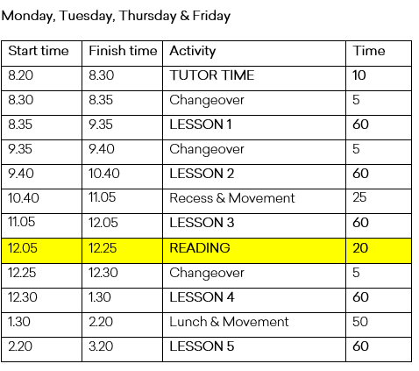
Shhh! - Sustained silent reading (SSR)
timetable for SSR Program 2020
Notes:
All lessons are now 60 minutes
Dedicated 5 minutes changeover/movement time between all periods
Recess has been extended by 5 minutes
Lunch has been extended by 5 minutes
The reading session will sit between Period 3 and Period 4
Classes will stay in their Period 3 room to read

Slide 12
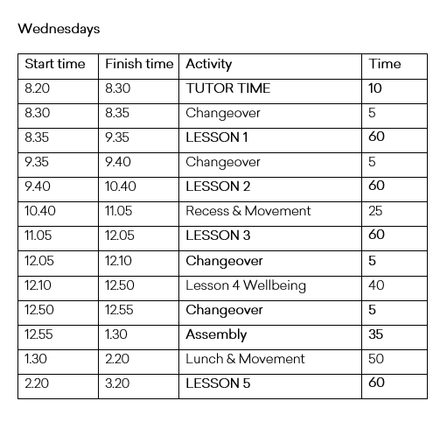
Shhh! - Sustained silent reading (SSR)
Proposed timetable for SSR Program 2020
Notes:
All lessons are still 60 minutes
Dedicated 5 minutes changeover/movement time between all periods
Recess has been extended by 5 minutes
Lunch has been extended by 5 minutes
Assembly will start 5 minutes earlier at 12.55pm and conclude at 1.30pm

Slide 13
Reading K-12
Whole school initiative to promote reading for pleasure
From January 2020 the Junior School SSR time (formally known as DEAR)
All grades K-2 to engage in 15 minutes SSR time in the 8:20am – 8:40am time slot each day.
It is critical to involve students in Kindergarten onwards even though these children are at ‘pre-reading’ level. They are still able to ‘read’ by taking meaning from simple picture books or textless or limited text books. Reading at this age level goes far beyond words on a page and incorporates visual literacy and the reading of images and illustrations.
All grades 3 – 6 to engage in 15 minutes SSR time in the 2:45pm – 3:00pm timeslot each day.
All JS specialists and JS Executive will join a classroom during these times to read with the class and classroom teacher.
Notes:
DEAR will be known as SSR – we need to keep language consistent across K – 12
SSR time will be increased to 15 minutes
A Senior School teacher asked me recently ‘what do kindergarten do?’ during this time.
Specialists and JS Executive will join a classroom during these times to read with the class and classroom teacher.

Slide 14
Reading K-12
Whole school initiative to promote reading for pleasure
Currently Reading posters
Staff at both JS and SS were asked what book(s) they are
currently reading for pleasure. For the first round the following
staff were involved:
The Qliteracy committee received feedback and based on this we have reviewed how we will display the ‘Currently reading’ posters in both Junior and Senior campuses and we have just relaunched this.
Senior School Gabrielle Mace Merrilyn Lean Kim Elith | Junior School Isaac Dargan Vanessa Collins Angela Toohey
Notes:
This has taken longer than I wished for it to take to get traction.
We received feedback and based on this we have reviewed the process and how we will display the ‘Currently Reading’ project

Slide 15
Reading K-12
Whole school initiative to promote reading for pleasure
Currently Reading posters
These posters were designed to engage and interest students in what teachers are reading and enjoying.
Our aim is to encourage students to read widely and diversely.
The Junior School ‘Currently Reading’ posters will now focus on a favourite K – 6 book and will be renamed as a recommendation or favourite read i.e. ‘Ms Toohey recommends’
The Senior School ‘Currently Reading’ posters will remain the same but will be displayed in a different way, showcasing 16 teachers reads at a time. These will be displayed at Lawrence, Art and 44 campuses and renewed each term.
Notes:
Designed to engage and interest students in what teachers are reading and enjoying
Our aim is to encourage students to read widely and diversely
The Junior School posters will now focus on a favourite or highly recommended K – 6 book and will be renamed as a recommendation or favourite read. i.e. Mrs Toohey recommends…
Junior School teachers when I asked what would be a book for K – 6 that they would recommend they reel off 10 books in 10 seconds. JS teachers make reading recommendations all the time.
What I’m hoping with the ‘recommends or favourite read’ is that JS teachers can manipulate what they recommend based on who is in their class and who is going to note this recommendation every day as it’s on their classroom door.
The Senior School posters will remain the same but displayed in a different way, showcasing 15 teacher reads at a time.
Now on display at Lawrence, in the Library and 44 campuses.

Slide 16
Mrs Toohey
LOVED READING…
Notes:
The posters look like this.
Rach Brown – students talking about Rachel reading ‘horror books’. This is so important for students to see that teachers read WAY outside their subject area.
Lara Harvey – reading a very gritty book called ‘Marching Powder’
Authenticity of not censoring what you are reading in Senior School is critical.
In Junior School teachers should feel able to offer a range of favourite or recommended reads. Picture books, Early Readers, Younger Reader novels and Young Adult.
In Junior School setting this is another method of prompting conversation around what JS teachers have loved to read.

